Slide 1
FYP5: Object Detection, Tracking and Suspicious Activity Recognition for Maritime Surveillance using Thermal Vision

Slide 2
Training Results for STA Resnet - Classification Task
Dataset : UCF24 (sub-set of the UCF-101 dataset )
Data loader :
Custom data loader that loads the frames of each video sequentially
Loads a clip at a time from each video – at each step changes the batch of videos loaded
Outputs [images, labels, reset_flag]

Slide 3
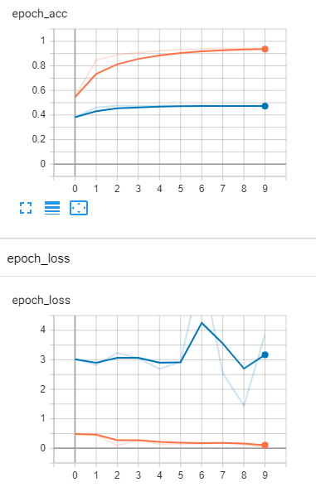
train
validation
Training Procedure :
Loaded images are preprocessed (normalization to 0-1 range)
When reset_flag is True (at the beginning of each clip returned) the states of the custom temporal layers are reset
Configurations :
Optimizer : Adam
Loss : SparseCategoricalCrossentropy
Learning rate : initial lr 0.001 - scheduled to decrease by 0.1

Slide 4
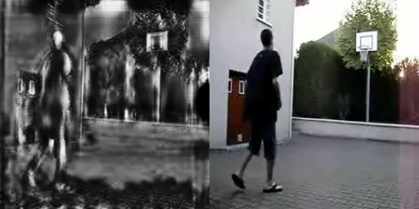
GAN – RGB to Thermal through style transfer
Frameworks we have tried in the last couple of weeks
CycleGAN – Unpaired image to image translation
BicycleGAN – Unpaired multimodal image to image translation
PIX2PIX – Paired image to image translation
Tried several variations of above frameworks
Resnet as the generator with different resolutions
Unet as the generator with different resolutions
No promising work in the RGB to Thermal translation
Working on the postprocessing methods and custom generators to enhance results
Best result so far – CycleGAN – after 100 epochs

Slide 5

Tasks for next week
Add the object detection head to the STA Resnet network and test with different configurations

